Slide 1

Edge Computing vs Cloud Computing
Presented by:
CH.SRI LAKSHMI ( 192311342 )
CSA1511 :CLOUD COMPUTING AND BIG DATA ANALYTICS
Date: 22/07/2026
Technical Presentation

Slide 2
Introduction
What is Edge Computing?
Edge computing processes data near the source where it is generated.
Reduces latency and bandwidth usage.
Suitable for real-time applications.
What is Cloud Computing?
Cloud computing processes and stores data in centralized remote data centers.
Provides scalable computing resources over the internet.
Supports large-scale data storage and analytics.

Slide 3
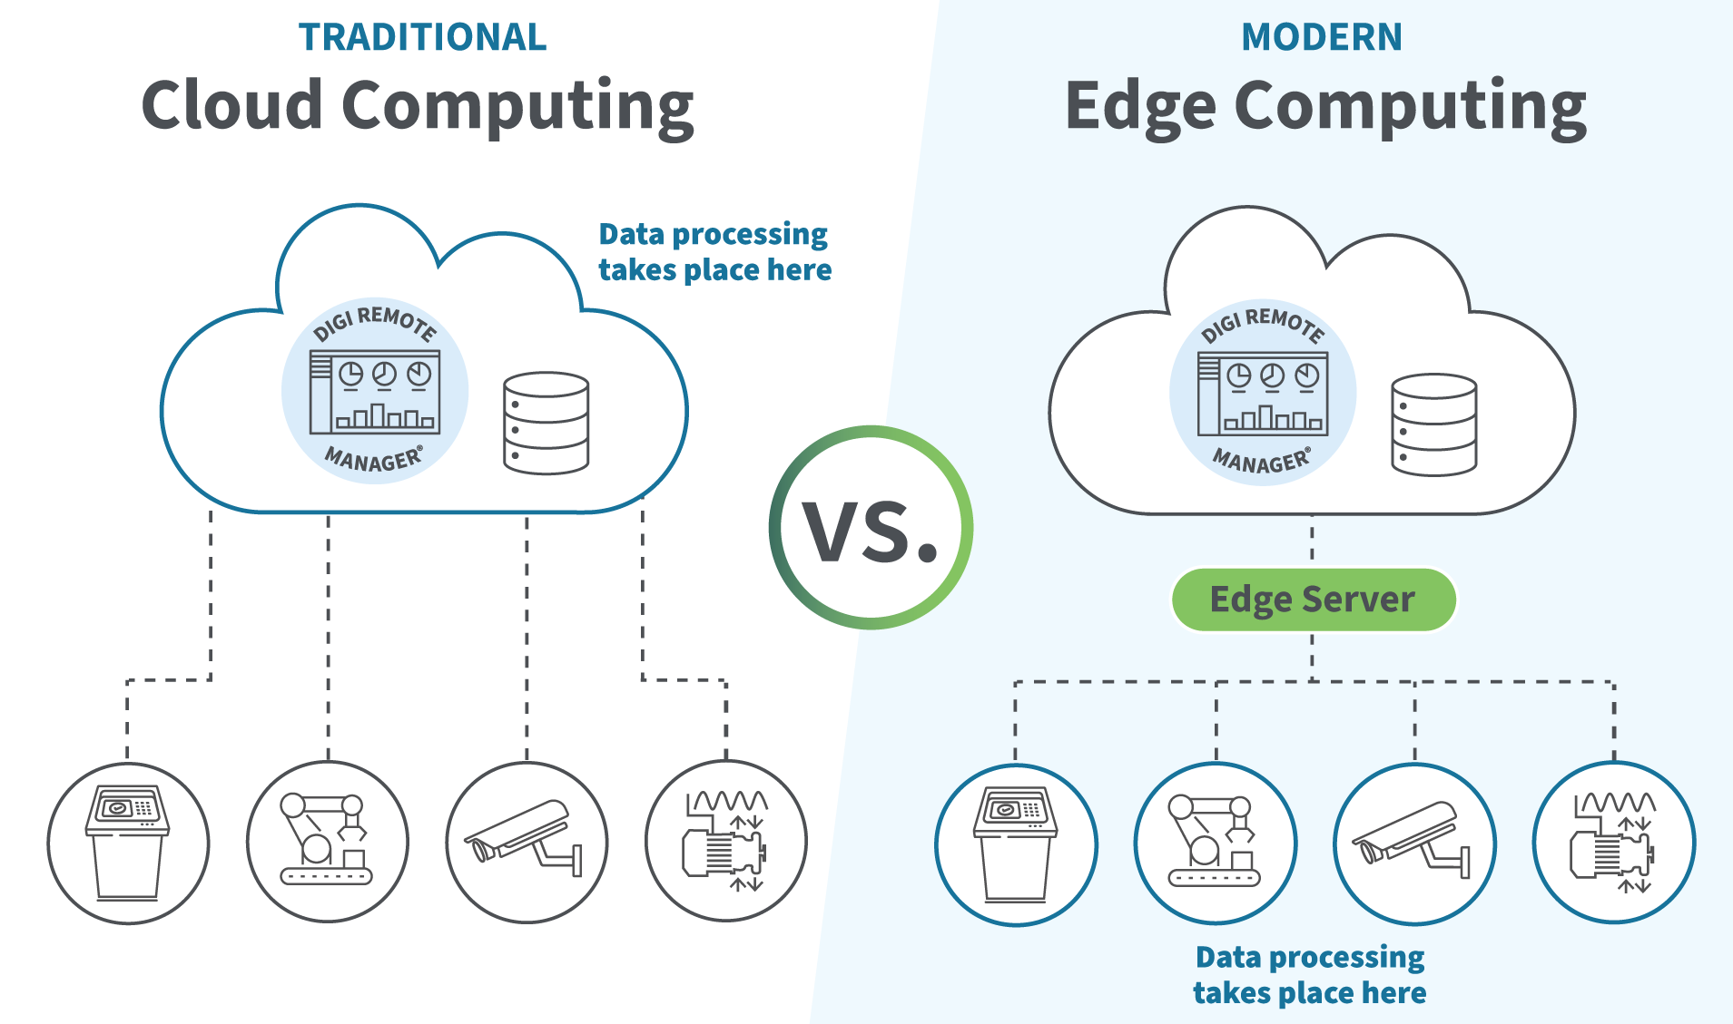

Slide 4
Core Technical Explanation
Edge Computing
Data is processed locally on edge devices or nearby edge servers.
Only important data is sent to the cloud.
Enables faster response time.
Cloud Computing
Data is transmitted to centralized cloud servers.
Cloud performs processing, storage, AI, and analytics.
Offers virtually unlimited computing resources.

Slide 5
BENIFITS
Edge Computing
Ultra-low latency
Faster decision making
Reduced bandwidth usage
Improved privacy
Works during limited internet connectivity
Cloud Computing
High scalability
Cost-efficient infrastructure
Powerful computing resources
Global accessibility
Easy backup and disaster recovery

Slide 6
Real-World Applications
Netflix – Cloud Computing
Stores and streams millions of movies and TV shows worldwide.
Uses cloud infrastructure to scale based on user demand.
Autonomous Vehicles (Tesla, Waymo) – Edge Computing
Self-driving cars process sensor and camera data locally.
Decisions like braking, steering, and obstacle detection require milliseconds.
Smart Manufacturing (Siemens, Bosch) – Edge + Cloud
Factory machines monitor temperature, pressure, and vibration.
Edge devices detect equipment failures instantly.
Cloud stores production data for long-term analysis.

Slide 7
Advantages
Reduced traffic congestion
Faster emergency response
Better fuel efficiency
Improved road safety

Slide 8
Conclusion
Edge computing provides fast local processing with minimal latency.
Cloud computing offers powerful centralized storage and computing.
Many modern systems combine Edge and Cloud for better performance.
The right computing paradigm depends on application requirements.

Slide 9


Thank You!!!

